Slide 1

Angry Birds AR
COMS W4172 Final Project
Shusen Xu
Xingjian Wu
Yiyang Zeng
Yumeng Jiang

Slide 2

4 Major Features of The Game
Slingshot
Scenes
Damage Effect
Wayfinding

Slide 3
Slingshot
Made to simulate a real slingshot. In the game, the slingshot consists of two parts: two flexible belts and a pad holding the ammo.
To control the slingshot, users need to tap on the pad to activate controlling, drag the pad towards a certain directions, and release the pad to fire the ammo

Slide 4

Scenes
Two scenes were constructed
Simulate the classic angry bird game feeling
Use simple objects such as cubes and cylinders, instead of the “fancy” models from asset stores. This is because:
we calculate the center of gravity for all of the simple objects to make sure the building bricks structure is stabilized
simple objects have more realistic physical reactions when hit by the slingshot or when colliding with each other

Slide 5
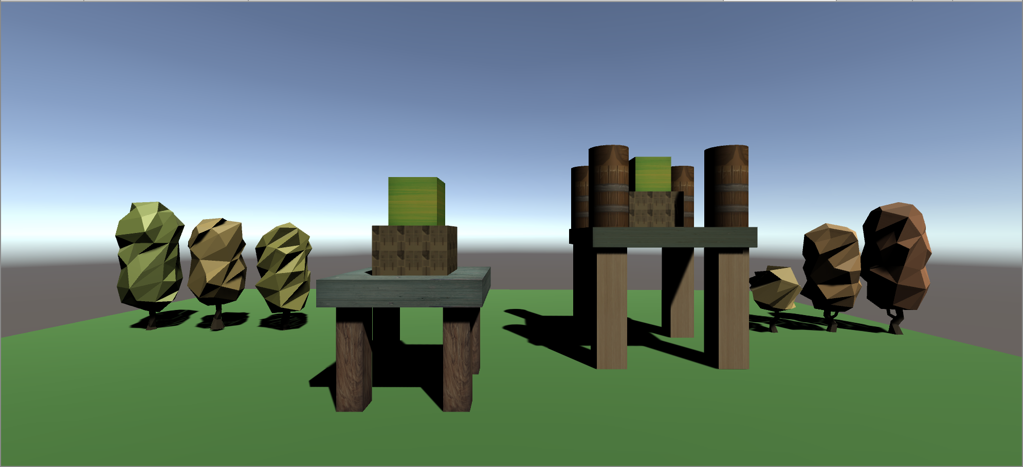
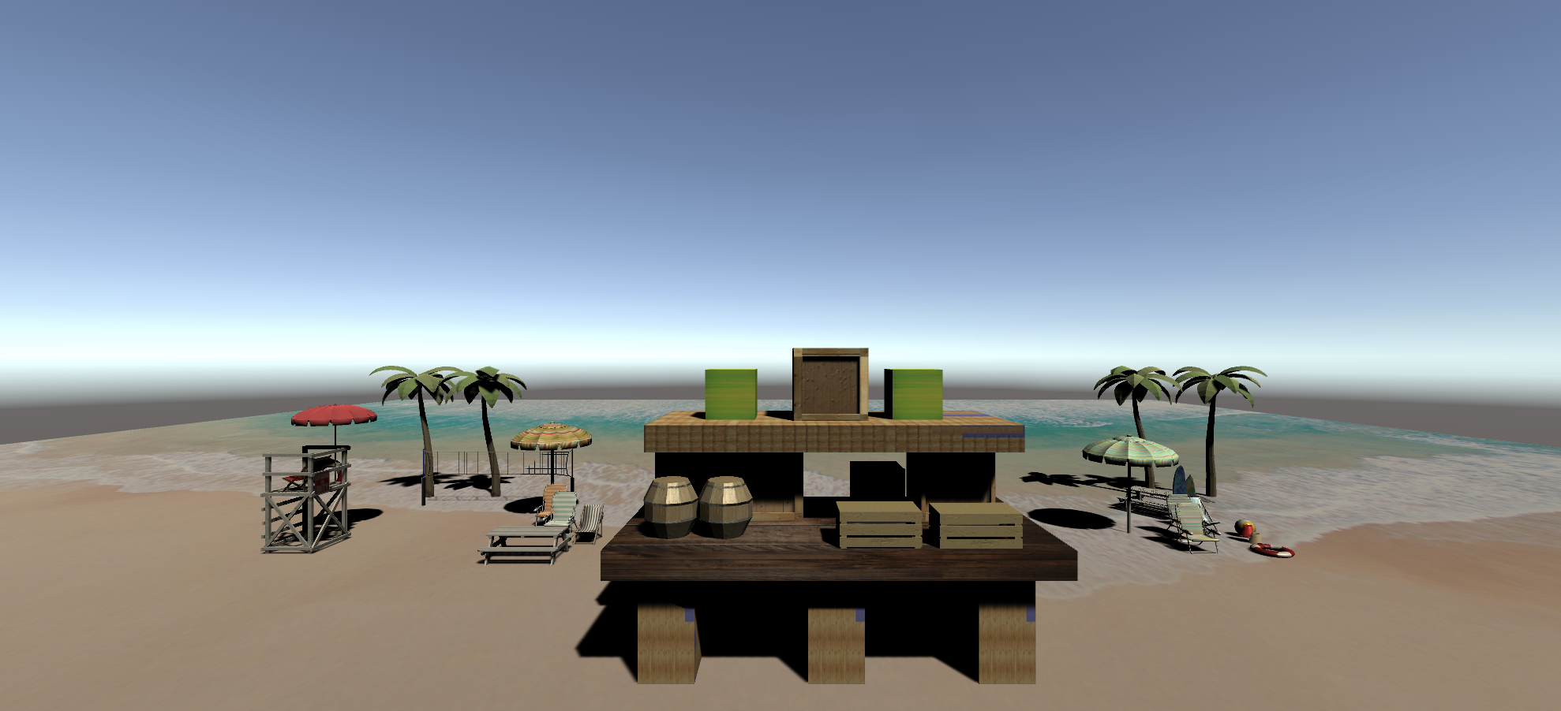
Scenes

Slide 6

Damage Effect
We refer to the original game Angrybird 2 for damage effect. We summarize the damages into three categories: Falling, Explosion, Collision.
Falling
When any unit drops out of the boundary, it disappears and gets destroyed immediately. It is an instant kill magic that wipes out all HP.
Explosion
Explosion has a larger effect area,would damage things inside circle with a shockwave. We decided not to implement this.

Slide 7
Damage Effect
Collision
Collision is the most common way to destroy bricks and enemies. Different objects with different forces would have different impacts.
Based on the discoveries, we give enemies and brick prefabs different HP and damage.
Different collisions would be reflected on the HP reducing the other collision object’s damage. When HP falls to 0 or under 0 , the unit is destroyed with a particle effect.

Slide 8

Wayfinding
In the game we have two image targets, each with one scene built on it.
At the start of the game, the camera in our device would capture both image targets.
It “remembers” the spatial information for both scenes including location and orientation.
Based on the spatial information, we basically build a cognitive map that divides scenes into distinct parts, and records the sequential relationship of the scenes.

Slide 9
Wayfinding
At this point, the user is free to move the camera around.
If either scene is out of the camera view, a list of arrows would appear on screen, following a proper trail that guides the user towards the proper view point of that following scene.
According to the relative spatial information, the arrows gradually change location and orientation.
In this way, the user would always know where to play both games.

Slide 10
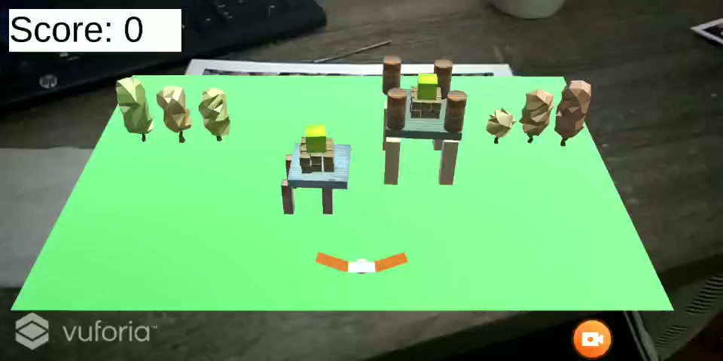
Demo

Slide 11
Thank you!

